Slide 1


FAQ, advanced grammar, tips and tricks
Peter Willendrup (pkwi@fysik.dtu.dk)

Slide 2
What is really the information content…?
McXtrace sources generally provide “intensity” in units of photons/s (into a chosen solid angle)
That intensity is carried through the instrument on a discrete set of “X-ray rays”

Slide 3
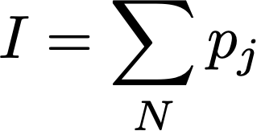
In a histogram sense
Imagine a histogram, e.g. I(λ)
The RMS variance over that set becomes our statistical error bar E
…
…
1
2
3
i
k
In bin i, N events each carrying a fractional intensity pj so that

Slide 4
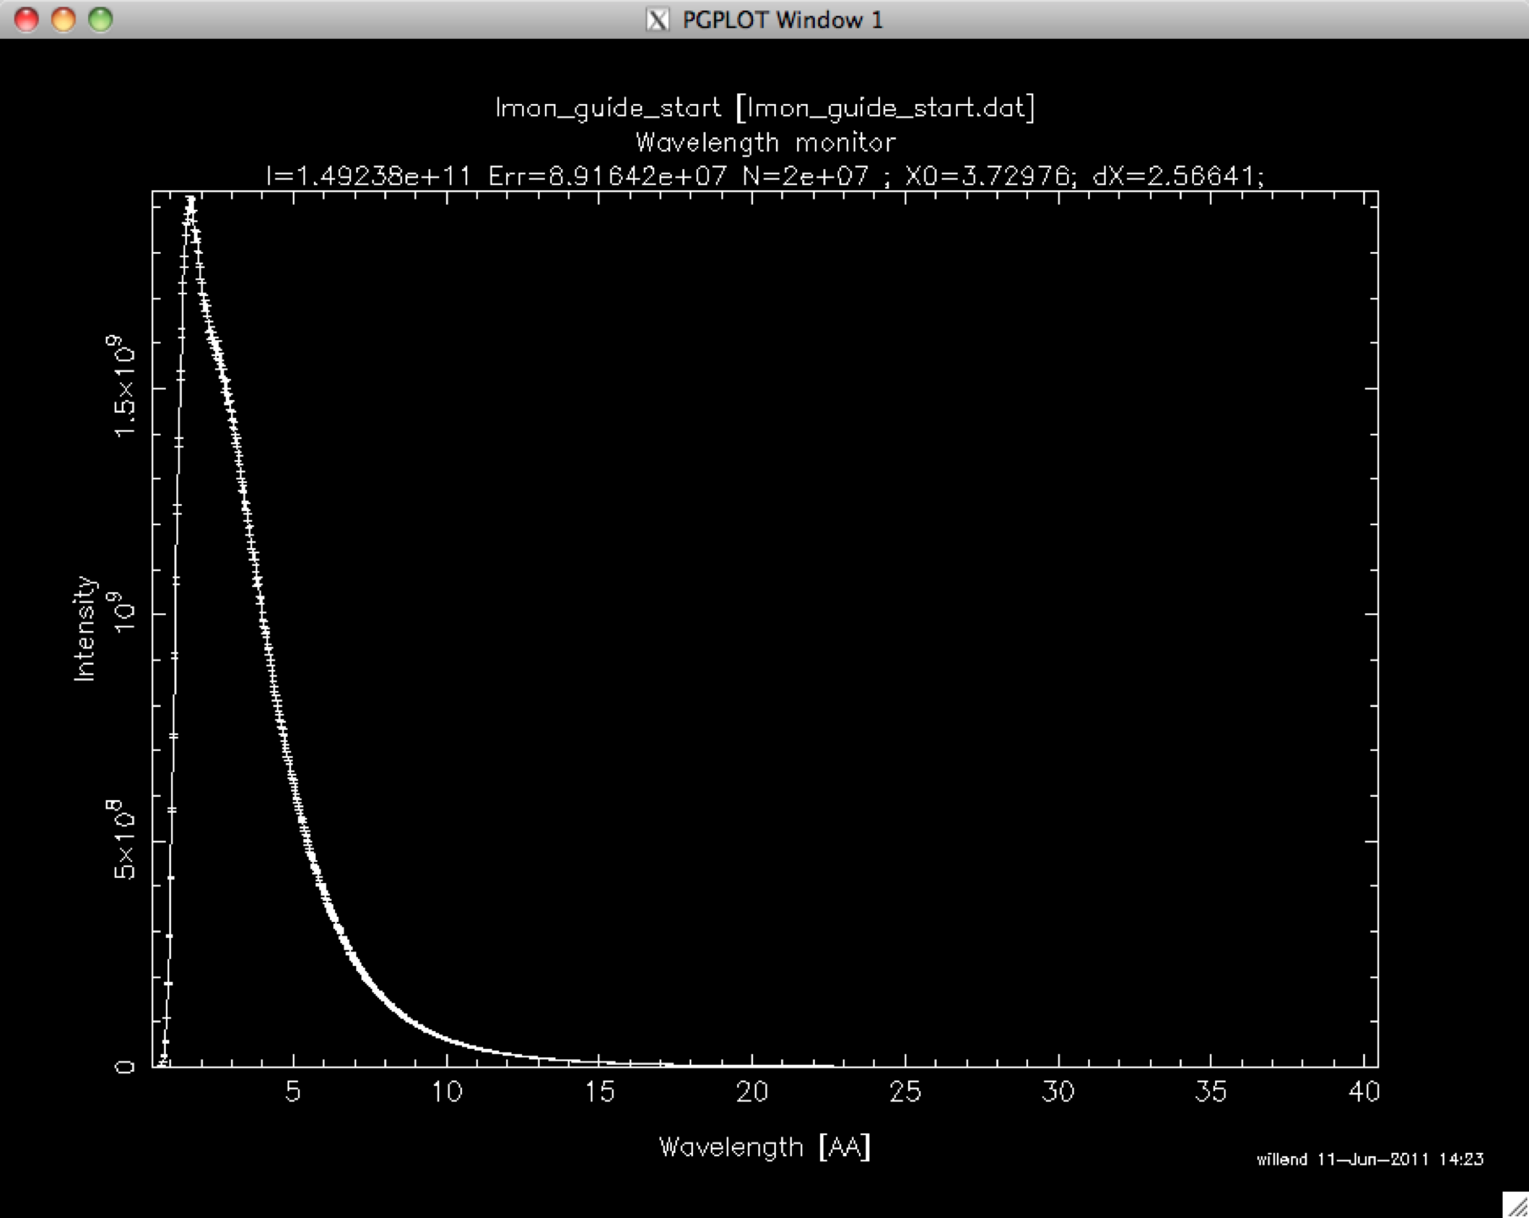
In a histogram sense
Imagine a histogram, e.g. I(λ)
The RMS variance over that set becomes our statistical error bar E
…
…
1
2
3
i
k
In bin i, N events each carrying a fractional intensity pj so that

Slide 5
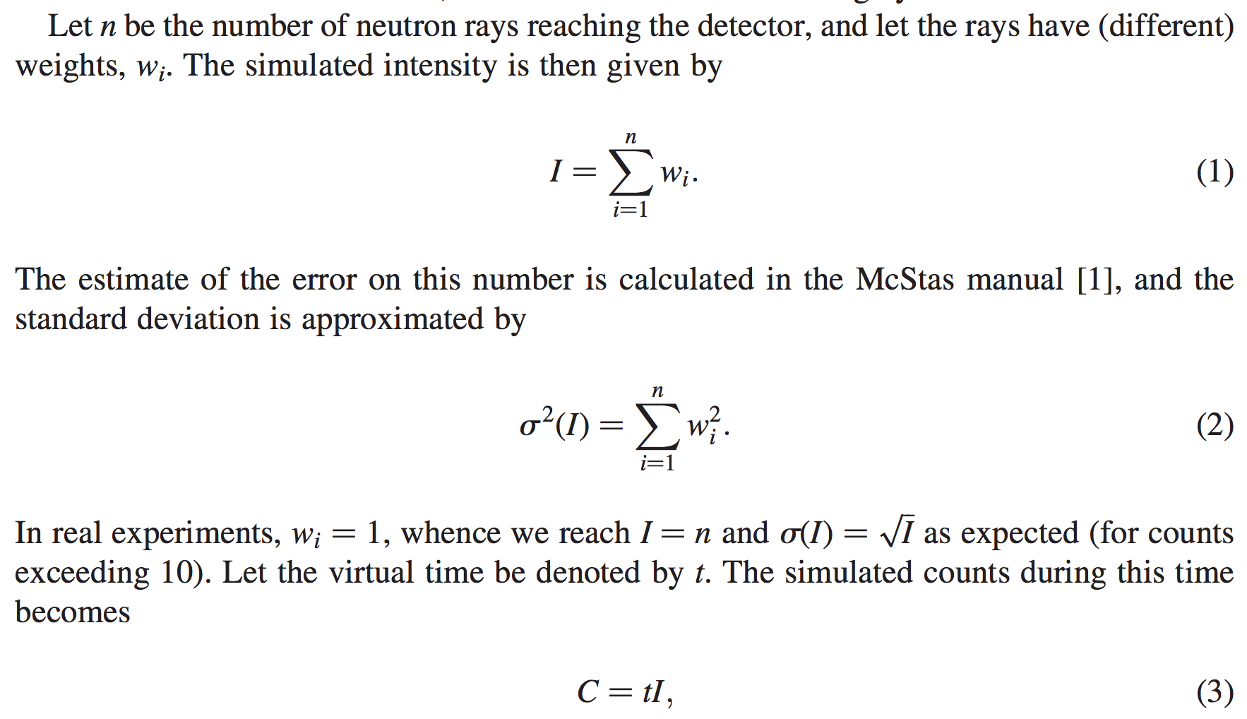
From "Virtual experiments - the ultimate aim of neutron ray-tracing simulations", K. Lefmann et al., Journal of Neutron Research 16, 97-111 (2008)

Slide 6
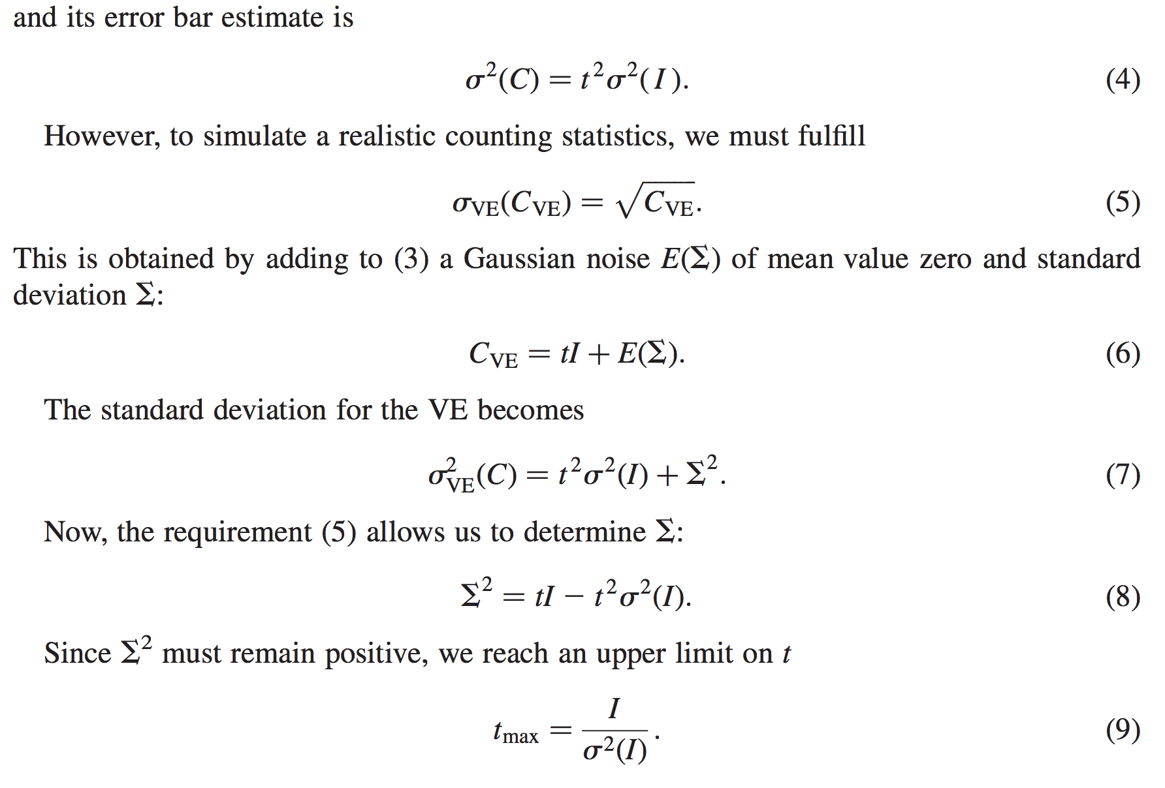
From "Virtual experiments - the ultimate aim of neutron ray-tracing simulations", K. Lefmann et al., Journal of Neutron Research 16, 97-111 (2008)

Slide 7
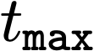
Sketch of an algorithm…
On a given McXtrace histogram
For the non-zero bins, calculate
The smallest defines the “maximal counting time” allowed by your statistics
Preferably a “background” should be added - use a “known experimental value” or an estimate…

Slide 8
Important points to remember
Your simulation will only contain elements you provided / defined
… to the precision you defined
Answers the questions you posed
Background essentially only from “sample”, or sample-near objects

Slide 9
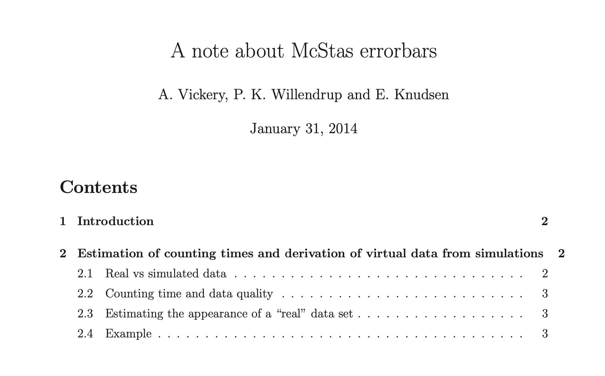
Errorbars maximum “integration time”
Lefmann, K., Willendrup, P. K., Udby, L., Lebech, B., Mortensen, K., Birk, J. O., ... Farhi, E. (2008). Virtual experiments: the ultimate aim of neutron ray-tracing simulations. Journal of Neutron Research, 16(4-4), 97. https://doi.org/10.1080/10238160902819684 Plus the attached note from Annette Vickery (also true for photons):

Slide 10
Onto efficiency…
Apply focusing techniques
At the source (spatially, temporally, in wavelength…)
At the sample, if possible
(carefully!) Apply SPLIT - but only if immediately followed by Monte Carlo choices, e.g. in sample
Alternatively use MCPL o/i which allows repetition - beware of biases!

Slide 11
Onto efficiency…
Apply focusing techniques
At the source (spatially, temporally, in wavelength…)
At the sample, if possible
(carefully!) Apply SPLIT - but only if immediately followed by Monte Carlo choices, e.g. in sample
Alternatively use MCPL o/i which allows repetition - beware of biases!
All of this can be considered “variance reduction”
or biasing

Slide 12
Onto efficiency…
Use MPI parallelisation - included in macOS install, easy to get on Linux…
The Intel C compiler is known to give ~factor of 2 wrt. gcc in most cases
- Still consider if you are asking the right question if runtimes reach days/weeks…

Slide 13
Cluster utility scripts
mcsub cluster scripts
Takes a “mxrun commandline”
Writes batch file “template” for use with PBS or slurm cluster queue systems
https://github.com/McStasMcXtrace/McCode/tree/master/tools/cluster-scripts
./mcsub_slurm.pl
Usage: ./mcsub_slurm.pl [options] [mcrun params]
-h --help Show this help
-rN --runtime=N Specify maximum runtime (hours) [default 1]
-qQNAME --queue=QNAME Specify wanted SLURM queue [default 'express']
-e<mail> --email=<mail> Specify address to notify in reg. sim status [default none]
--nodes=NUM Specify wanted number of nodes [default 1]
--name=NAME Specify slurm job name [default "McSub_<USERNAME>_<TIMESTAMP>"]
After running ./mcsub_slurm.pl NAME.batch is ready for submission using the sbatch command

Slide 14
Examples Directory
Simple grep →
25 examples of Monitor_nD
4 examples of Source_lab
4 examples of Undulator
5 examples of PowderN
Unix/Linux:
grep Monitor_nD /usr/share/mcxtrace/1.7/examples/*

Slide 15
Examples Directory
Simple grep →
370 examples of Monitor_nD
51 examples of Source_gen
10 examples of ISIS_moderator
10 examples of Single_crystal
They have an author name!
For instance:
DBD_IBM_Si_analyzer → Marcus H. Mendenhall
Test_SX → E. Farhi
Pump_probe → E. Knudsen

Slide 16
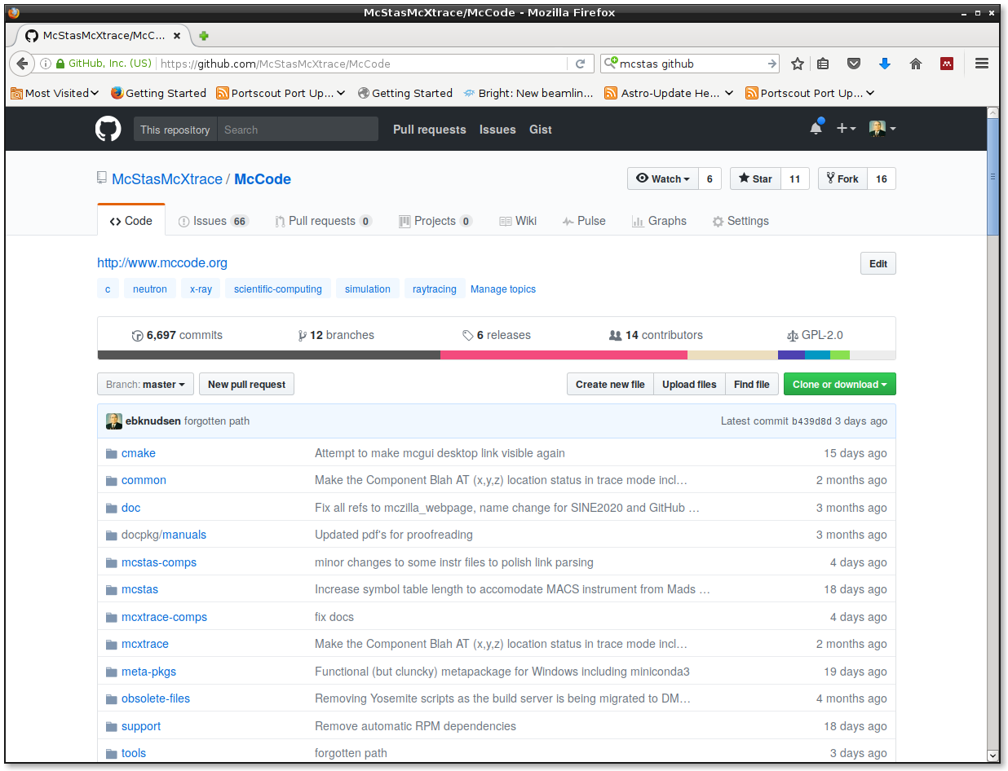
GitHub.com
https://github.com/McStasMcXtrace/McCode

Slide 17
GitHub.com
https://github.com/McStasMcXtrace/McCode

Slide 18
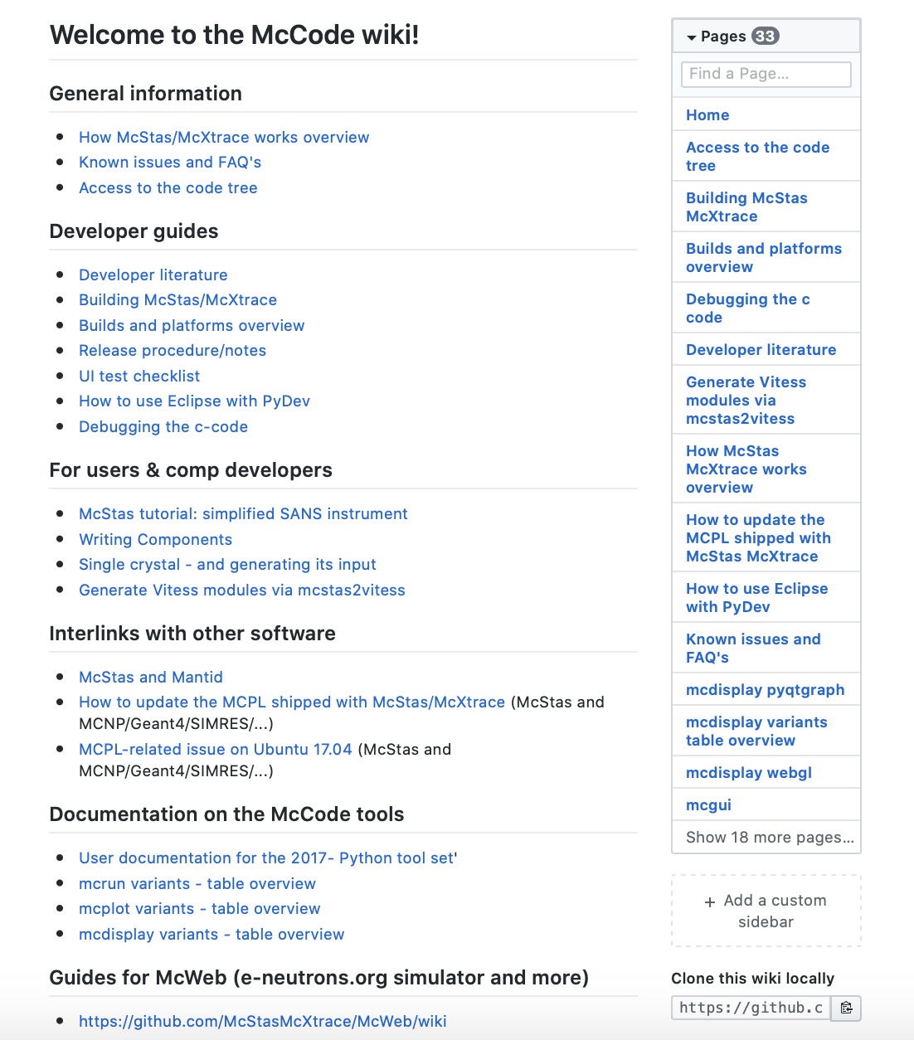
User- and developer docs
GitHub.com: wiki
}

Slide 19
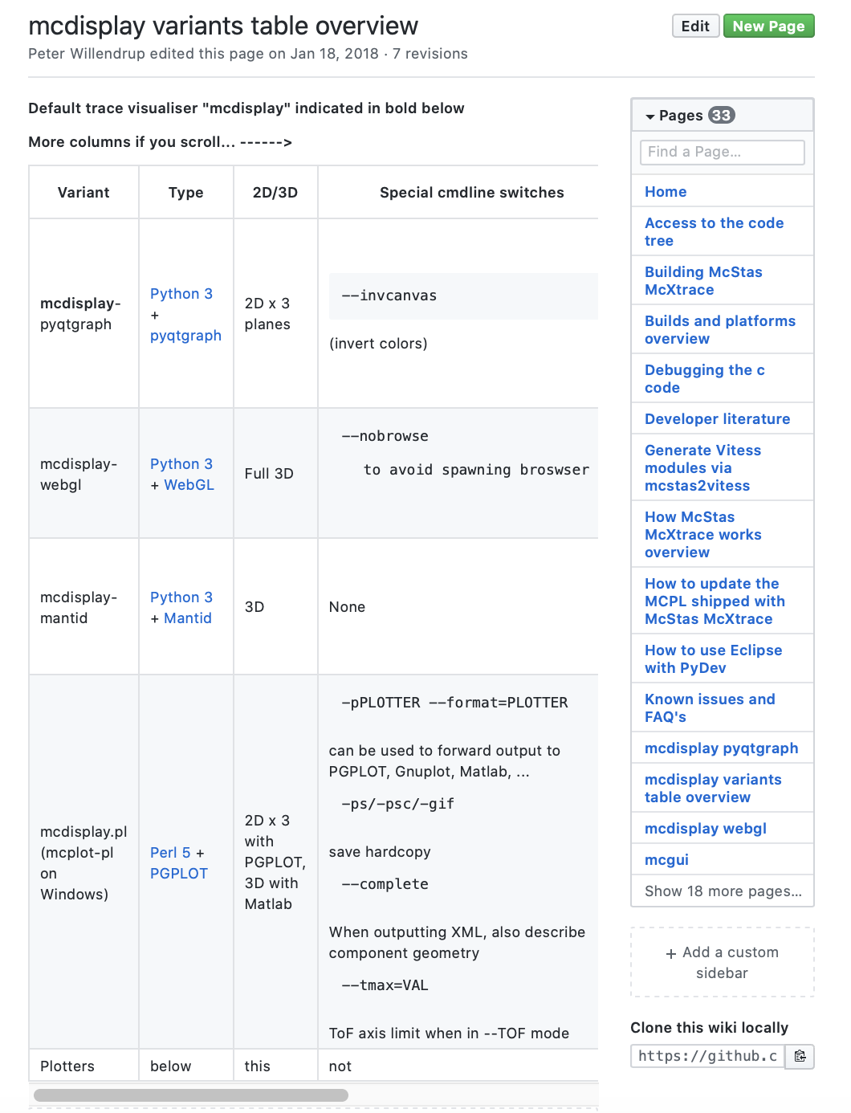
User- and developer docs
GitHub.com: wiki

Slide 20
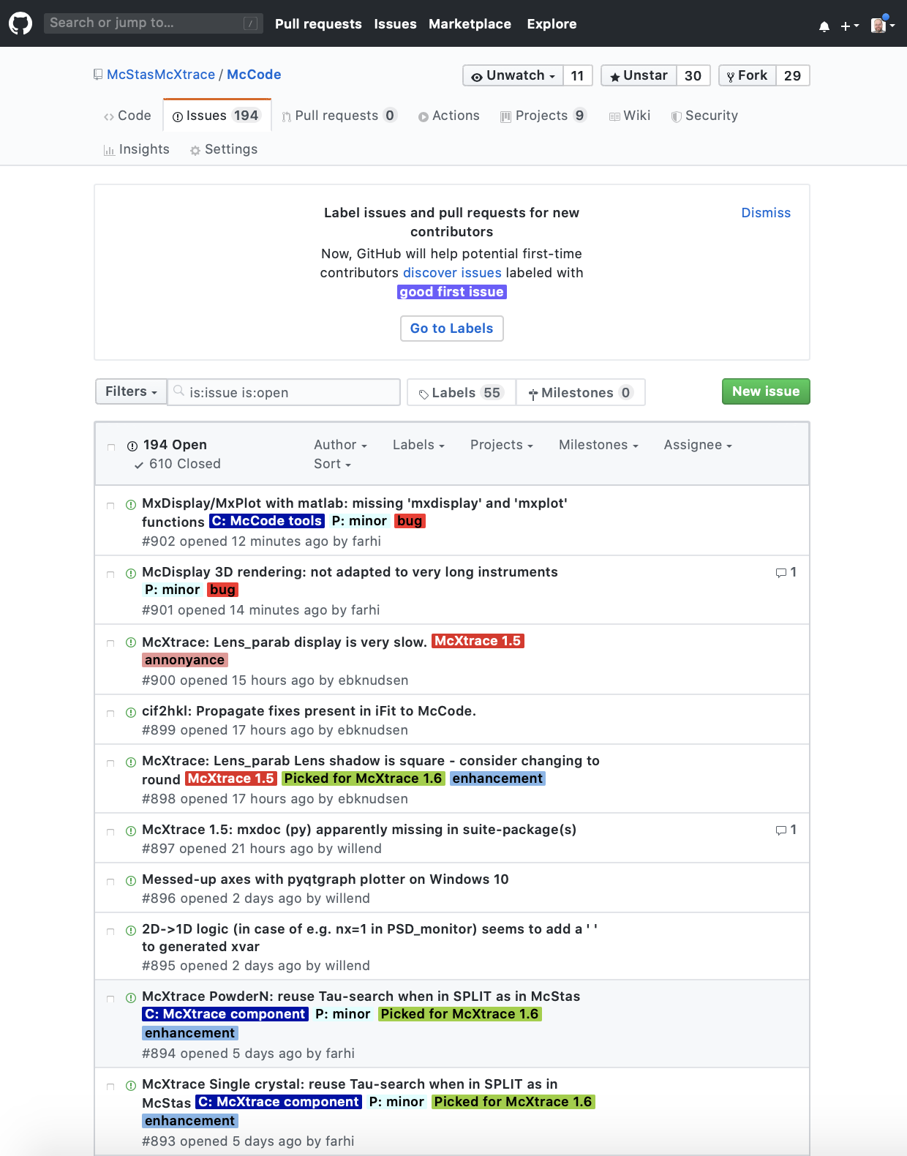
GitHub.com: Issue Tracker

Slide 21
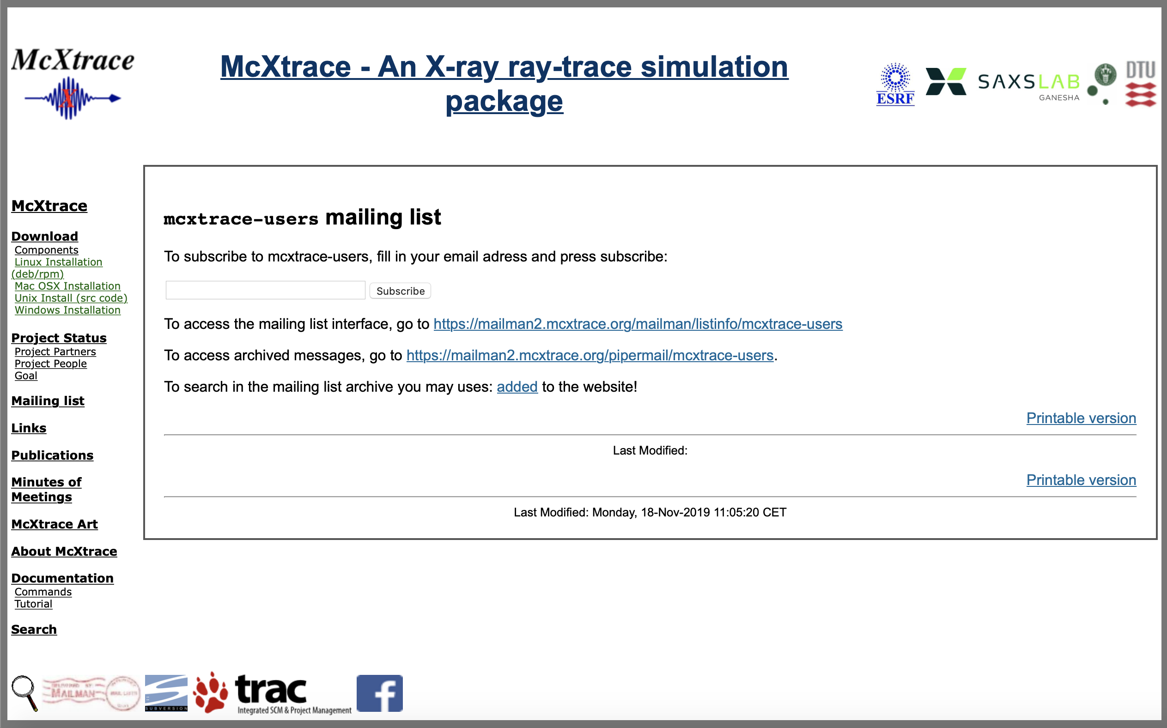
Mailing List

Slide 22
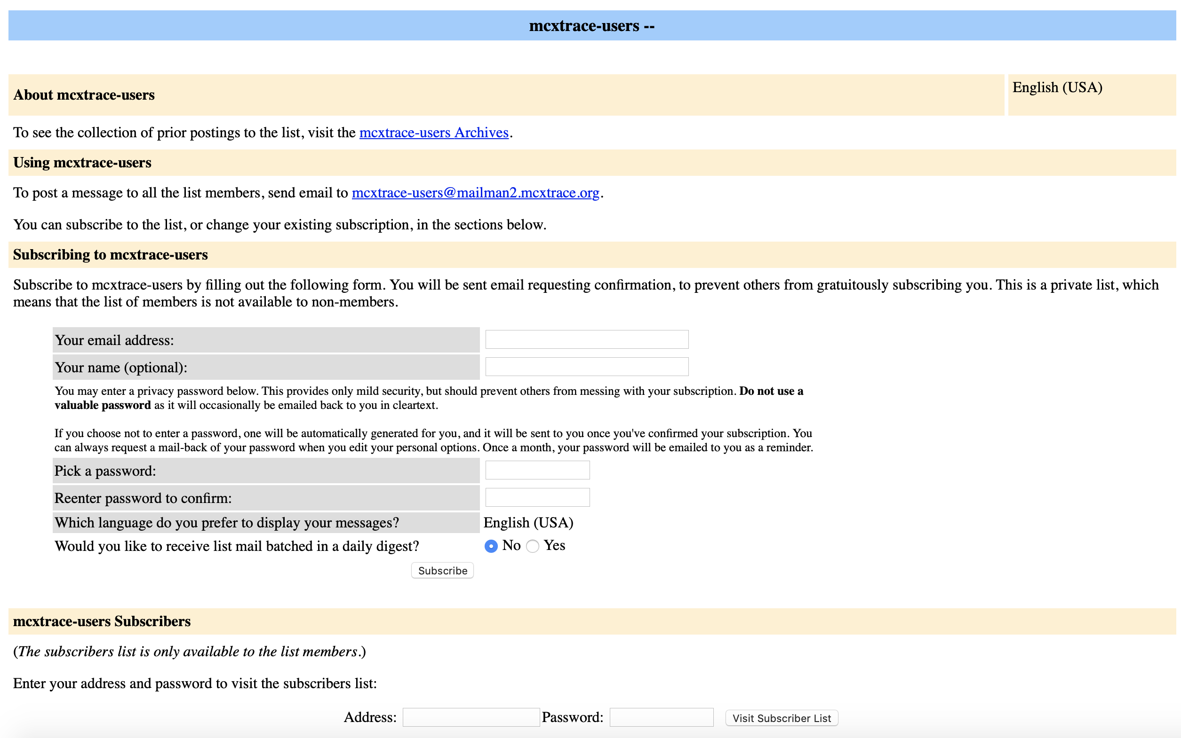
Mailing List

Slide 23
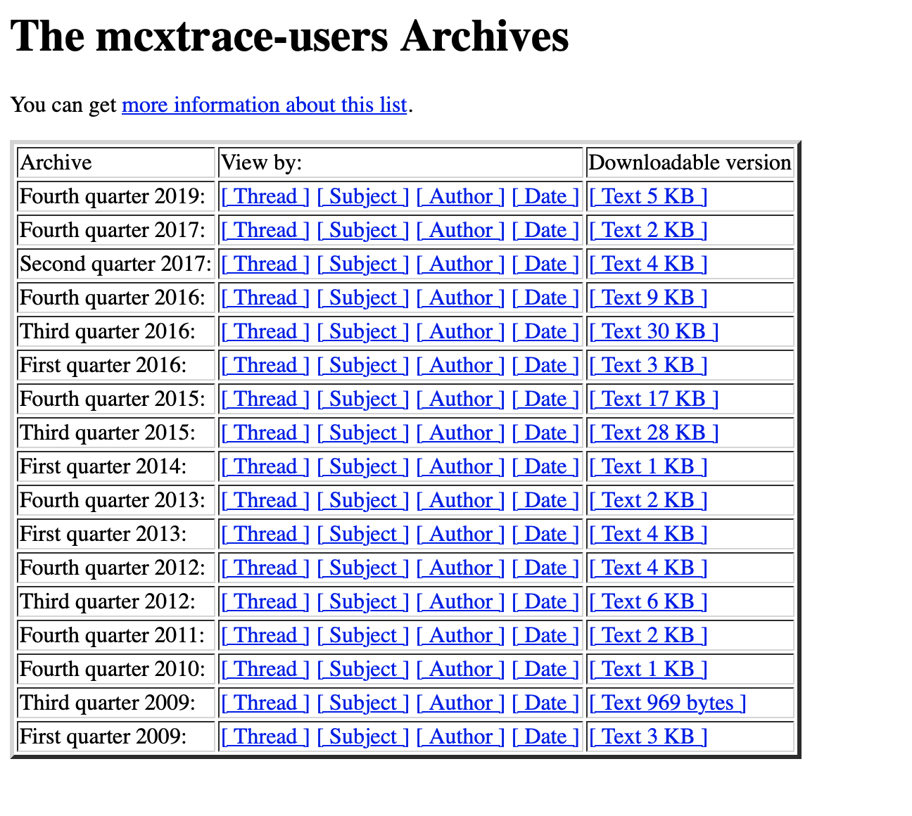
Mailing List - Archive
User forum and help since 2009!!
Spirit of the mailinglist:
Very friendly and open!
There is no such thing as a stupid question!
Often answers are given from users rather than developers, especially in areas that include very specific domain science.
contact: mcxtrace-users@mcxtrace.org

Slide 24
SPLIT, EXTEND, WHEN, COPY & GROUP (… and the dangerous JUMP)
Advanced language features:
Tips and tricks for your instrument

Slide 25
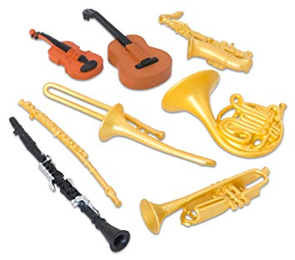
Syntax in one, complex view...
{SPLIT} COMPONENT name = comp(parameters) {WHEN condition}
AT (...) [RELATIVE [reference|PREVIOUS] | ABSOLUTE]
{ROTATED {RELATIVE [reference|PREVIOUS] | ABSOLUTE} }
{GROUP group_name}
{EXTEND C_code}
{JUMP [reference|PREVIOUS|MYSELF|NEXT] [ITERATE number_of_times | WHEN condition] }

Slide 26

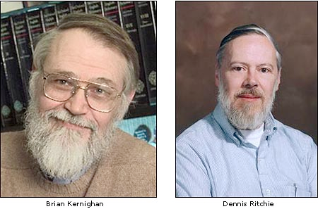

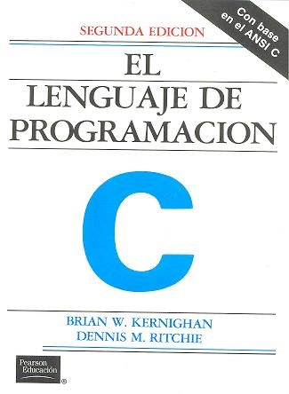
DECLARE / INITIALIZE
Use the DECLARE section define user variables and functions.
DECLARE %{
double myvar;
%}
Use INITIALIZE for initialization of user variables and calculations.
INITIALIZE %{
myvar = sqrt(PI*input_var)*rand01();
%}
- Both use normal c-syntax.
BEWARE: (example) What you do in the c-style areas is c-standard, e.g. trigonometric functions from math.h use radians! - McXtrace placement specifiers work in degrees, etc...
K & R. / GNU

Slide 27
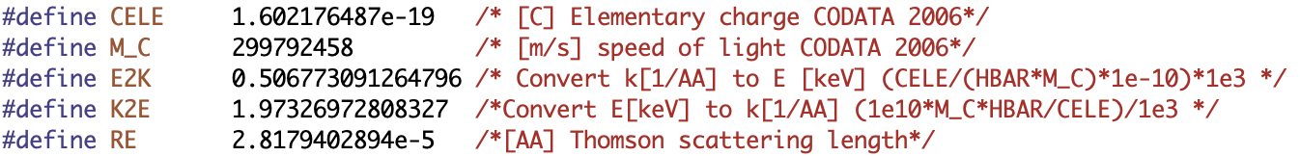
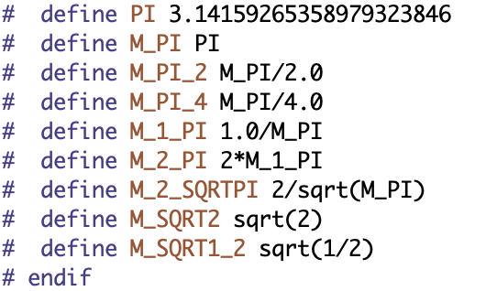
DECLARE / INITIALIZE
Useful physics constants:
plus e.g. DEG2RAD, RAD2DEG, and these math constants
plus anything you can imagine in terms of trigonometric functions from C <math.h>
(beware, these take radians as input - as opposed to our ROTATED statements)
Use the DECLARE section define user variables and functions.
DECLARE %{
double myvar;
%}
Use INITIALIZE for initialization of user variables and calculations.
INITIALIZE %{
myvar = sqrt(PI*input_var)*rand01();
%}
- Both use normal c-syntax.
BEWARE: (example) What you do in the c-style areas is c-standard, e.g. trigonometric functions from math.h use radians! - McXtrace placement specifiers work in degrees, etc...
K & R. / GNU
( )

Slide 28
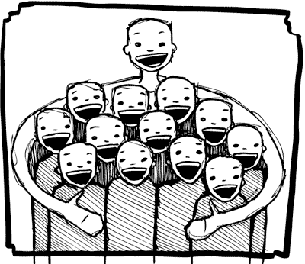
%include
Instrumentfiles can include external c-code or other instrumentfiles... (These are examples from McStas)
ILL_H15_IN6.instr:%include "monitor_nd-lib"
ILL_H16_IN5.instr:%include "ILL_H16.instr"
ILL_H25_IN22.instr:%include "ILL_H25.instr"
ILL_H25_IN22.instr:%include "templateTAS.instr"
Used in the DECLARE section

Slide 29
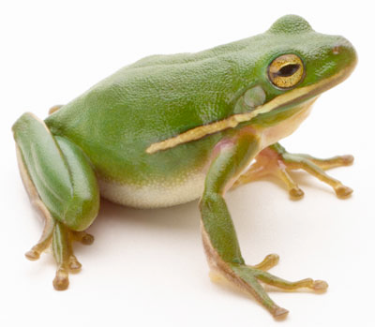
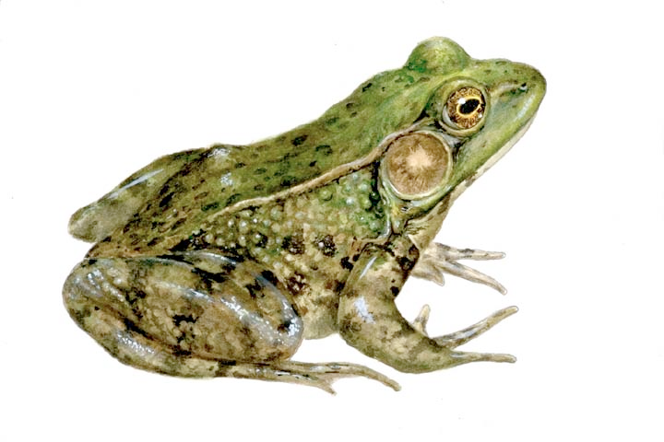
COPY- inside instruments
In instruments: (see e.g. ILL_H25.instr)
COMPONENT H25_1 = Guide_gravity(
w1=0.03, h1=0.2, w2=0.03, h2=0.2, l=L_H25_1,
R0=gR0, Qc=gQc, alpha=gAlpha, m=m, W=gW)
AT (0,0,Al_Thickness+gGap) RELATIVE PREVIOUS
ROTATED (0,Rh_H25_1,0) RELATIVE PREVIOUS
COMPONENT MYcopy = COPY(H25_1)
AT (0,0,L_H25_1+gGap) RELATIVE PREVIOUS
ROTATED (0,Rh_H25_1,0) RELATIVE PREVIOUS
COMPONENT COPY(H25_1) = COPY(H25_1)(W=2*gW)
AT (0,0,L_H25_1+gGap) RELATIVE PREVIOUS
ROTATED (0,Rh_H25_1,0) RELATIVE PREVIOUS

Slide 30

GROUP - components working in parallel
COMPONENT Mono1 = Monochromator_curved(...)
AT (0,0,-LMM) RELATIVE Cradle ROTATED (0,A1/2,0) RELATIVE Cradle
GROUP IN6Monoks
COMPONENT Mono2 = Monochromator_curved(...)
AT (0,0,0) RELATIVE Cradle ROTATED (0,A2/2,0) RELATIVE Cradle
GROUP IN6Monoks
- One comp after the particle is “tried” in sequential order until the it becomes SCATTERED.

Slide 31

WHEN
Syntax:
COMPONENT Mine = Yours(blah, blah)
WHEN (c-expression) AT (....)
Is very powerful when combined with EXTEND and user variables, or as a method to let input parameters select if certain components are active.
Example: Use EXTEND to flag if neutron was scattered on one monochromator blade or another. Then later use WHEN to only show contribution from blade N at sample position?
COMPONENT Mon = PSD_monitor(...)
WHEN (myvar==1) AT (0,0,0) RELATIVE Sample

Slide 32
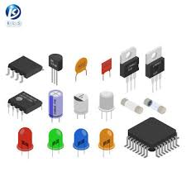
EXTEND
Enrich component behaviour using EXTEND:
COMPONENT Mono1 = Monochromator_curved(...)
AT (0,0, -LMM) RELATIVE Cradle ROTATED (0,A1/2,0) RELATIVE Cradle
GROUP IN6Monoks
EXTEND
%{
if (SCATTERED) { myvar = 1; }
%}
...
COMPONENT Mono2 = Monochromator_curved(...)
AT (0,0, 0) RELATIVE Cradle ROTATED (0,A2/2,0) RELATIVE Cradle
GROUP IN6Monoks
EXTEND
%{
if (SCATTERED) { myvar = 2 ;}
%}
K & R. / GNU

Slide 33
Combined example: Decompose multiple scattering from Single_crystal
DECLARE %{
double multiple_scatt;
%}
…
COMPONENT Crystal = Single_crystal(… order=0 …)
AT (0,0,0) RELATIVE somewhere
EXTEND %{
multiple_scatt=SCATTERED;
%}
…
COMPONENT PSD_single=PSD_monitor(…)
WHEN (multiple_scatt==1) AT (0,0,0) RELATIVE somewhere_else
COMPONENT PSD_multiple=PSD_monitor(…)
WHEN (multiple_scatt > 1) AT (0,0,0) RELATIVE somewhere_else

Slide 34
JUMP
A goto. Be careful. Can be used in two situations:
JUMP to myself
JUMP to an Arm
No coordinate transformations are applied... (Meaning that if the Arms you JUMP between do not coincide you will “move” / “reorient” the photons...)
Syntaxes:
COMPONENT a=b(...)
WHEN (expr) AT (...) JUMP somewhere
COMPONENT a=b(...)
WHEN (expr) AT (...) JUMP myself
Van Halen...

Slide 35
JUMP
A goto. Be careful. Can be used in two situations:
JUMP to myself
JUMP to an Arm
No coordinate transformations are applied... (Meaning that if the Arms you JUMP between do not coincide you will “move” / “reorient” the neutrons...)
Syntaxes:
COMPONENT a=b(...)
WHEN (expr) AT (...) JUMP somewhere
COMPONENT a=b(...)
WHEN (expr) AT (...) JUMP myself
BEWARE - This IS a GOTO!
Van Halen...

Slide 36
JUMP
A goto. Be careful. Can be used in two situations:
JUMP to myself
JUMP to an Arm
No coordinate transformations are applied... (Meaning that if the Arms you JUMP between do not coincide you will “move” / “reorient” the neutrons...)
Syntaxes:
COMPONENT a=b(...)
WHEN (expr) AT (...) JUMP somewhere
COMPONENT a=b(...)
WHEN (expr) AT (...) JUMP somewhere
BEWARE - This IS a GOTO!
Van Halen...

Slide 37
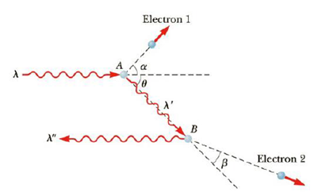
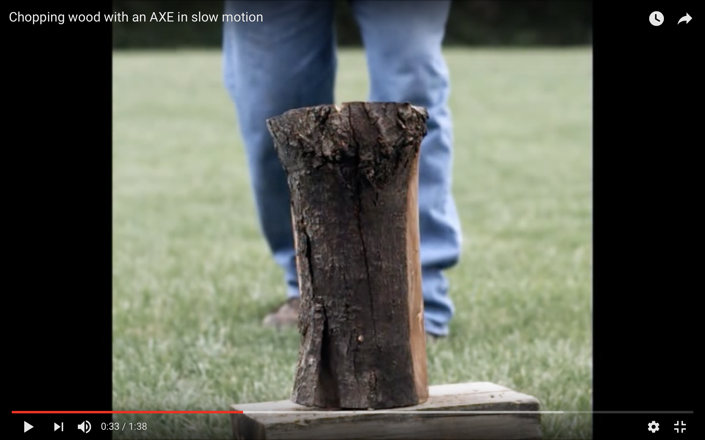
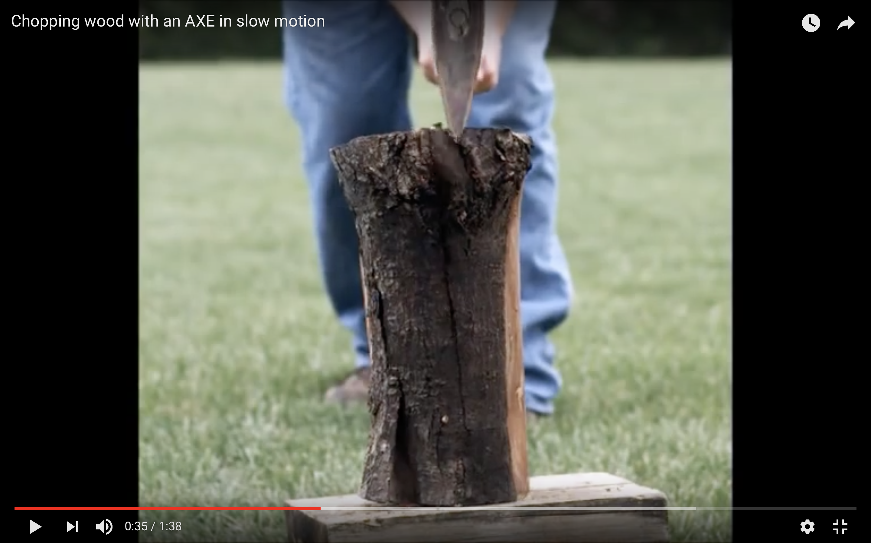
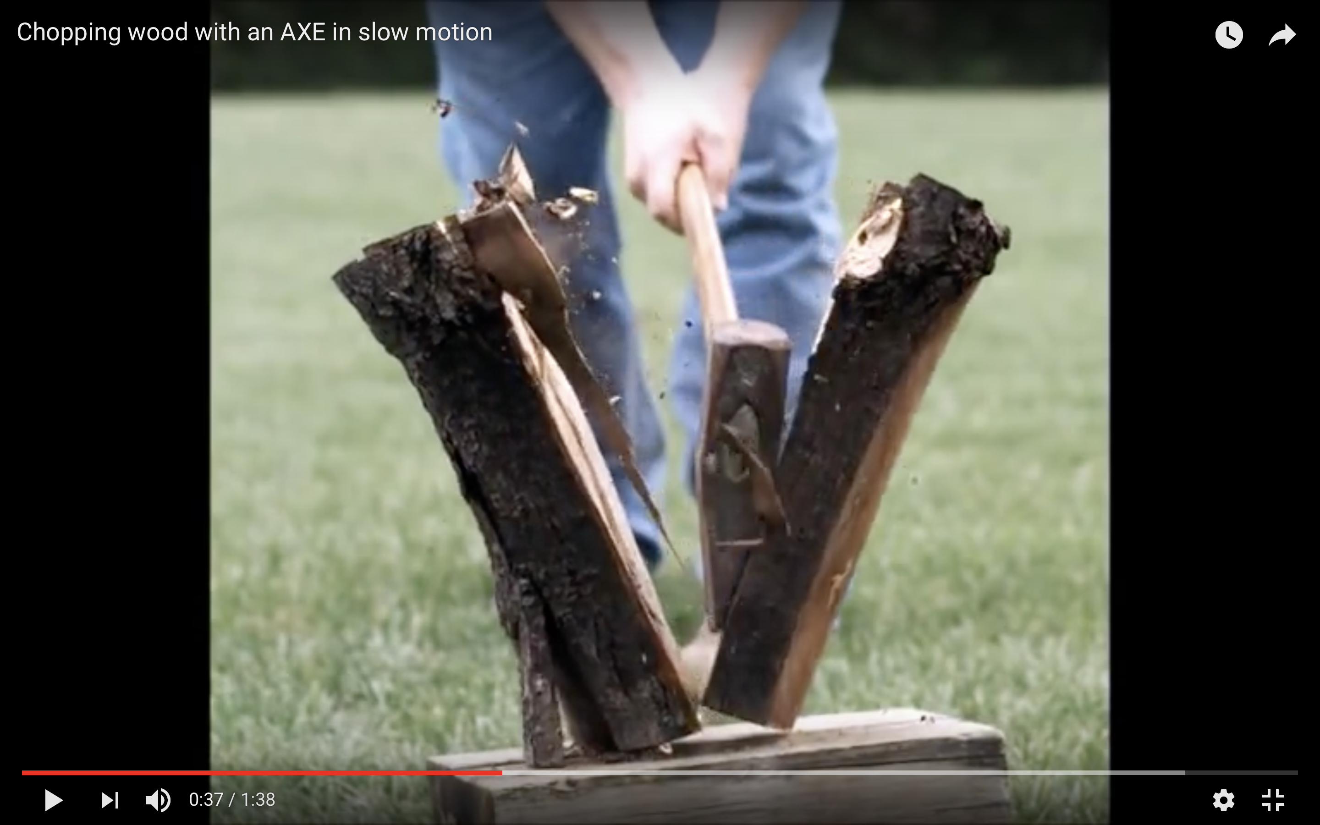
SPLIT
Increase statistics beyond this point in the instrumentfile
SPLIT n MyArm = Arm()
AT somewhere
will “formulate an if-statement”:
for j=1:n
comp1
comp2
comp3
...
end (of instrument)
ONLY meaningful in case of Monte Carlo choices after SPLIT point...

Slide 38
SPLIT
Increase statistics beyond this point in the instrumentfile
SPLIT n MyArm = Arm()
AT somewhere
will “formulate an if-statement”:
for j=1:n
comp1
comp2
comp3
...
end (of instrument)
ONLY meaningful in case of Monte Carlo choices after SPLIT point...
Works very well together
with e.g. monochromators, Single_crystal, PowderN

